Slide 1
Memory:
Interference and Retrieval
HUDK 4029: Human Cognition and Learning

Slide 2
How much of your sense of self comes from your memories?

Slide 3
Types of
Declarative Memory
Semantic:
Memory for facts, or the capacity for recollecting facts and general knowledge about the world.
Episodic
“the capacity for recollecting happenings from the past, for remembering events that occurred in particular spatial and temporal contexts.”
Squire, L. R., & Zola, S. M. (1998). Episodic memory, semantic memory, and amnesia. Hippocampus, 8(3), 205-211.

Slide 4
What were the words from either list last week? Write down as many as you can remember.

Slide 5
Did you have….
Purse?
Ocean?
Tooth?
Towel?
Paper?

Slide 6
Meaning vs meaningless (for some!)
Bag
Sand
Tooth
Rug
Pen
Luz
Rey
Pez
Miel
Red

Slide 7
Retrieval

Slide 8
What does retrieval mean? Under what circumstances can it most efficiently occur?

Slide 9
The Testing Effect
What is the test effect? What did the two studies demonstrate?
Why is retrieval practice effective?
Draws attention to missing information
Retrieval effort strengths memory
Elaborative retrieval hypothesis
(Or retrieval practice)

Slide 10
The Testing Effect
Any concerns with this as a laboratory procedure? How can we potentially extend this to classroom practice?
Consider the role of teacher-provided feedback. How do you think this might interact with the test effect as described by Roediger and Karpicke?
(Or retrieval practice)

Slide 11
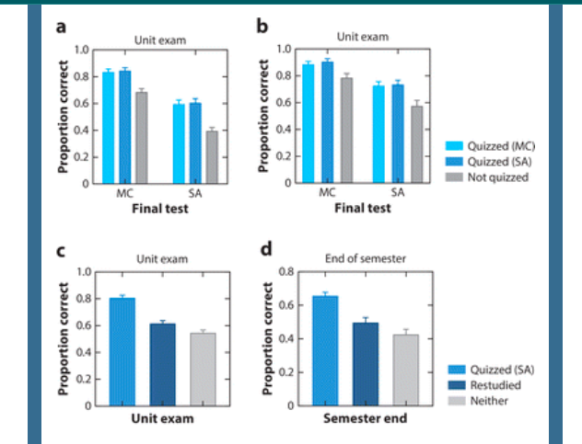
Retrieval practice in the real world
McDermott, K. B., Agarwal, P. K., D'Antonio, L., Roediger III, H. L., & McDaniel, M. A. (2014). Both multiple-choice and short-answer quizzes enhance later exam performance in middle and high school classes. Journal of Experimental Psychology: Applied, 20(1), 3.

Slide 12
But we don’t remember everything, even things we’d want to remember. Why do you think that is?

Slide 13
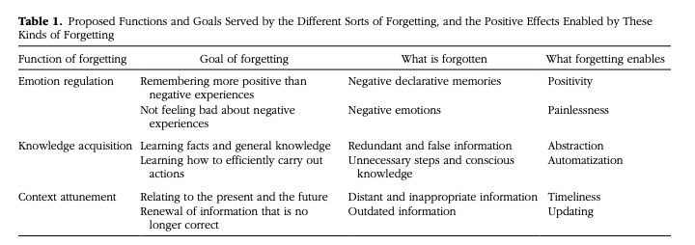
Why might forgetting be adaptive?
Nørby, S. (2015). Why forget? On the adaptive value of memory loss. Perspectives on Psychological Science, 10(5), 551-578.

Slide 14
Interference

Slide 15
Fake News
What is a deep fake and why are they specifically something to be concerned about?
Can you think of an instance where fake news influenced you or someone you know?
What does this mean, if anything, for media satire and/or features of the target audience?
Liv, N., & Greenbaum, D. (2020). Deep fakes and memory malleability: False memories in the service of fake news. AJOB neuroscience, 11(2), 96-104.

Slide 16
The Misinformation Effect
Video: Elizabeth Loftus (2:40)

Slide 17
On False Memory Debriefing…
There is a noted “continued influence effect” in the literature for memory studies that include deception
Debriefing seems to reduce the BELIEF that an action was performed, but some not necessarily disrupt the false memory that had formed.
An enhanced debriefing (with more information on how memory works and where the specific misinformation was planted) seems to alleviate some of the issue.
Of interest: Otgaar, H., Candel, I., Merckelbach, H., & Wade, K. A. (2009). Abducted by a UFO: Prevalence information affects young children's false memories for an implausible event. Applied Cognitive Psychology: The Official Journal of the Society for Applied Research in Memory and Cognition, 23(1), 115-125.
Greenspan, R. L., & Loftus, E. F. (2022). What happens after debriefing? The effectiveness and benefits of postexperimental debriefing. Memory & Cognition, 50(4), 696-709.

Slide 18
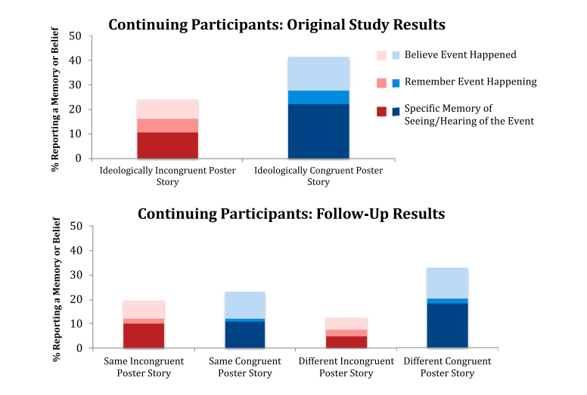
Murphy, G., Loftus, E., Grady, R. H., Levine, L. J., & Greene, C. M. (2020). Fool me twice: How effective is debriefing in false memory studies?. Memory, 28(7), 938-949.

Slide 19
How much of your sense of self comes from your memories?

Slide 20

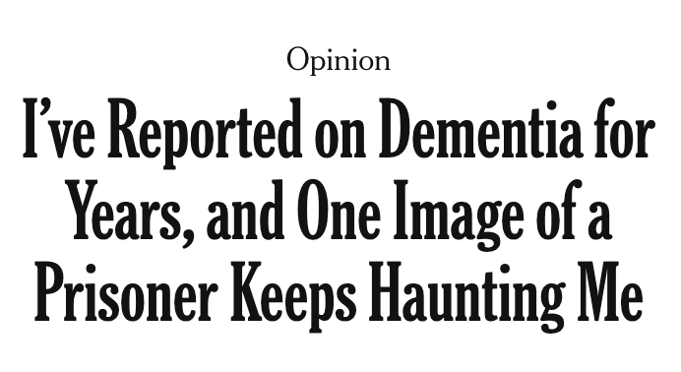
https://www.nytimes.com/2023/08/11/opinion/dementia-prisons.html#:~:text=Even%20people%20with%20dementia%20who,round%2Dthe%2Dclock%20care.

Slide 21
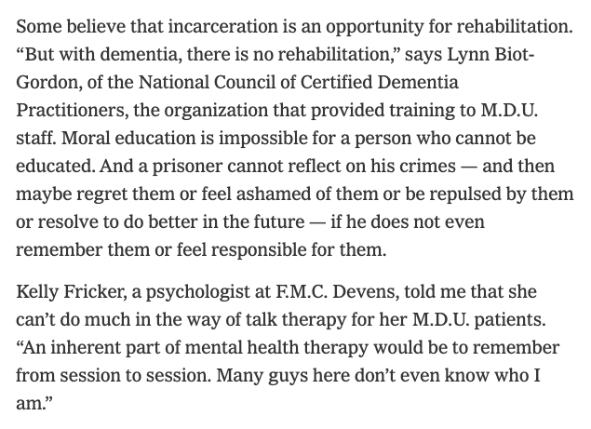

Slide 22
